Slide 1
Recursive partitioning methods or trees
Feedback Research Expert Meeting Marjolein Fokkema

Slide 2
Contents
What are recursive partitions? How are they trees?
Advantages of trees
Tree method I: Linear mixed-effects model trees
Tree method II: Prediction rule ensembles

Slide 3

What are recursive partitioning methods?
Recursive partitioning methods
recursively split the observations in a dataset based on their predictor variable values
into subgroups of observations that are increasingly similar in terms of the outcome.
Subgroups can be depicted as rectangular areas or nodes of a tree

Slide 4
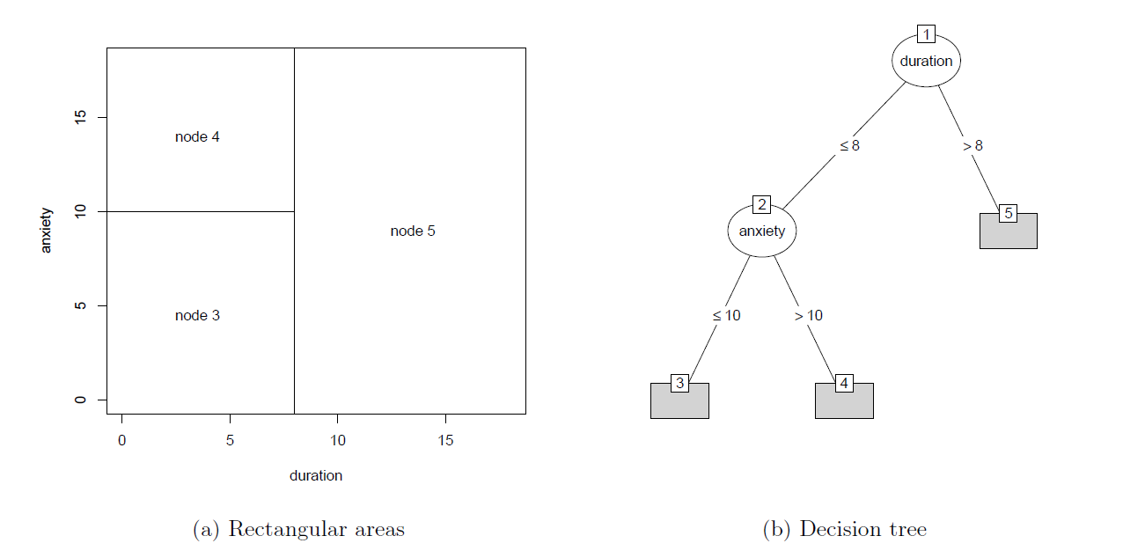

Slide 5
Advantages of tree methods
Data-analytic flexibility
Predictor variables may be categorical, ordinal or continuous
No (few) assumptions about the data distribution
Automatically accommodate interactions and non-linear effects
Can deal with many potential predictor variables
Easy to interpret and apply
Direct identification of subgroups
Easy to use in decision making
Not all variables need to be assessed

Slide 6
Tree method I: mixed-effects model trees
Motivation: Finding moderators in IPDMA dataset of on depression treatments
Pooled datasets (N = 694) from 7 RCTs comparing
Cognitive Behavioral Therapy (CBT)
Pharmaco therapy (PHA)
Outcome: posttreatment score on HDRS
Potential moderators of treatment effect:
Age
Gender
Educational level
Pretreatment HDRS score
Presence of comorbid anxiety disorder
…

Slide 7
Model-based recursive partitioning
Framework developed by Zeileis, Hothorn & Hornik (2008)
Rationale:
An overal parametric model (e.g., y = Xβ + ε) may not fit the data well
It may be possible to partition the dataset with respect to additional covariates, and find better-fitting models in each cell of the partition
Resulting partition is a tree with parametric models in the terminal nodes

Slide 8
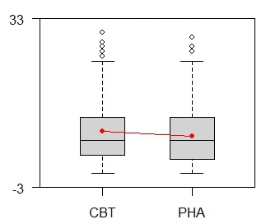
Overal parametric model
y = Xβ + ε
Additional covariates:
Age
Gender
Educational level
Pretreatment score on depression rating scale
Presence of comorbid anxiety disorder
…

Slide 9
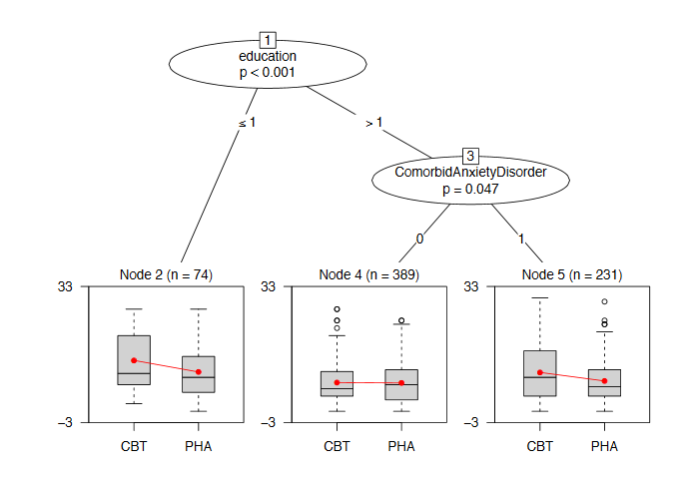
Linear model tree
Note: different value for β in every terminal node

Slide 10
Linear mixed-effects model tree
Usual linear mixed-effects model:
y = Xβ + Zb + ε
Fixed-effects (population level) part Xβ
Random-effects (cluster-specific) part Zb
Linear mixed-effects model tree (Fokkema et al. 2015b):
Partitions Xβ using a linear model tree
Estimates random effects b as usual (globally)

Slide 11
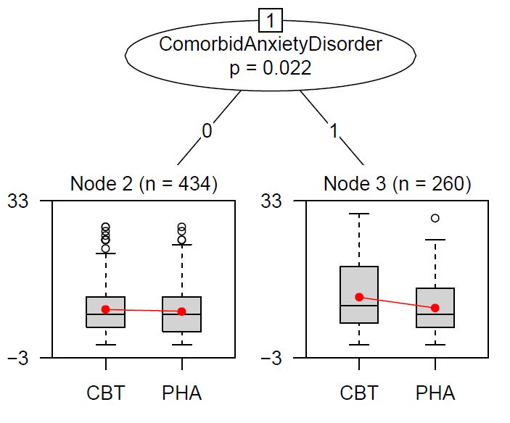
Linear mixed-effects model tree
LMM tree: Predictive accuracy (based on 50-fold CV): .28 (SD = .26)
LM tree: Predictive accuracy (based on 50-fold CV): .19 (SD = .28)

Slide 12

Comparative performance of linear mixed-effects model trees
Simulations show that linear mixed-effects model trees:
Accurately recovered treatment-subgroup interactions in 90% of datasets
Have low Type-I error rate (4%)
Show better accuracy than other tree algorithms and mixed-effects models with pre-specified interaction terms
Implemented in R package glmertree

Slide 13
Try this at home?
https://tinyurl.com/glmertree-tutorial
Mixed-effects model trees:
Aardoom, J. J., Dingemans, A. E., Fokkema, M., Spinhoven, P., & Van Furth, E. F. (2017). Moderators of change in an Internet-based intervention for eating disorders with different levels of therapist support: What works for whom? Behaviour Research and Therapy, 89, 66-74.
Fokkema, M., Smits, N., Zeileis, A., Hothorn, T. & Kelderman, H. (2015b). Detecting treatment-subgroup interactions in clustered data with generalized linear mixed-effects model trees. Working Papers in Economics and Statistics of the University of Innsbruck, 2015-10.
Zeileis, A. & Fokkema, M. (2016). glmertree: Generalized Linear Mixed Effects Model Trees. R package version 0.1.1; available from https://r-forge.r-project.org/R/?group_id=261.
Zeileis, A., Hothorn, T., & Hornik, K. (2008). Model-based recursive partitioning. Journal of Computational and Graphical Statistics, 17 (2), 492-514.

Slide 14
Tree method II: Prediction rule ensembles

Slide 15


Trees
Good: Easily interpretable and applicable
Bad: Not most accurate method
Ugly: Unstable

Slide 16
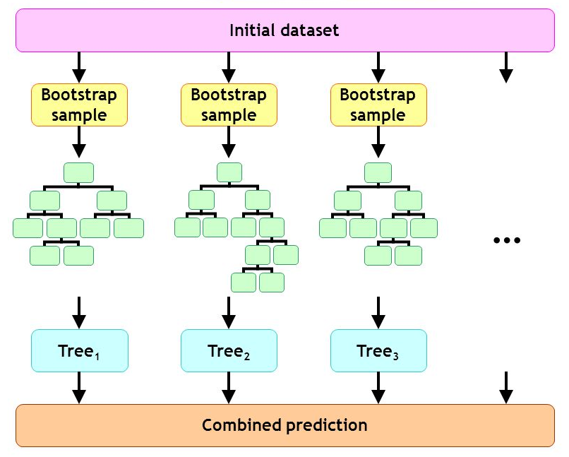
Tree ensembles

Slide 17
Tree ensembles
+ High predictive accuracy
Difficult to interpret
many (complex) trees
Difficult to apply
prediction for new observations requires a lot of computation and information
Solution: Prediction rule ensembles
Select only nodes that improve predictive accuracy most, from all trees in the ensemble
Every node is a very simple tree: a rule
Rulefit (Friedman & Popescu, 2008), Node Harvest (Meinshausen, 2010)

Slide 18
Rulefit algorithm for deriving prediction rule ensembles
Take sub- or bootstrap samples from training data
Grow tree on every sample
Using classification and regression tree algorithm of Breiman et al. (1984)
Create initial ensemble
Include every node from every tree as a rule, and/or
Include predictor variables as linear functions
Select final ensemble by sparse regression on training data
Lasso, ridge or elastic net
Optimal value of penalty term determined by k-fold cv

Slide 19
Prediction rule ensembles: Application
Penninx et al. (2006) studied predictors of chronicity among patients with current depressive and/or anxiety disorders (N = 1209)
Found 6 significant predictors using logistic regression:
Presence of comorbid disorder
Age
Depression questionnaire score
Fear questionnaire score
Presence of agoraphobic disorder
Age at onset of disorder
Likely

Slide 20
Prediction rule ensembles: Application
Penninx et al. (2006) studied predictors of chronicity among patients with current depressive and/or anxiety disorders (N = 1209)
Found 6 significant predictors using logistic regression:
If [0.72 * Presence of comorbid disorder + 0.02 * Age + 0.09 * Depression questionnaire score + 0.02 * Fear questionnaire score - 0.43 * Presence of agoraphobic disorder - 0.02 * Age at onset of disorder > 1.37] then [high risk of chronicity]
Likely to be used by clinicians?

Slide 21
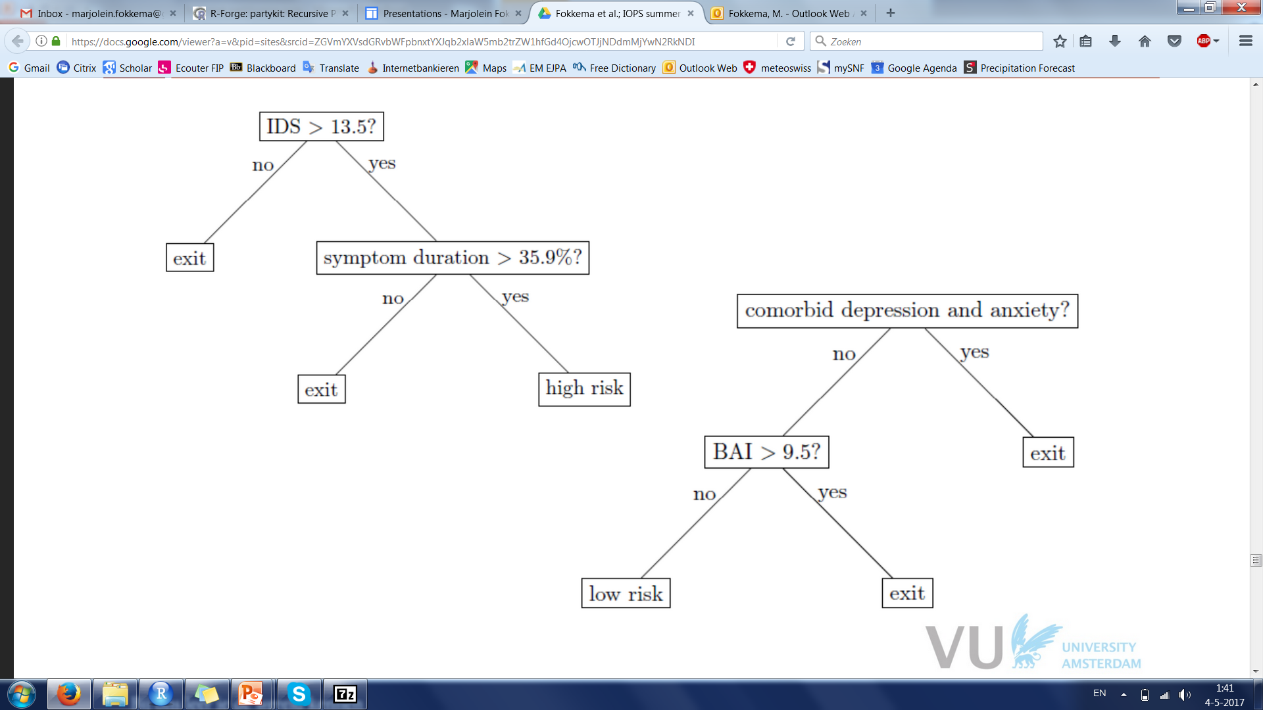
Prediction rule ensembles: Application
In Fokkema et al. (2015b), we used Rulefit to find predictors of chronicity in the same dataset
Result: two rules predicting chronicity
HHHAHHH

Slide 22
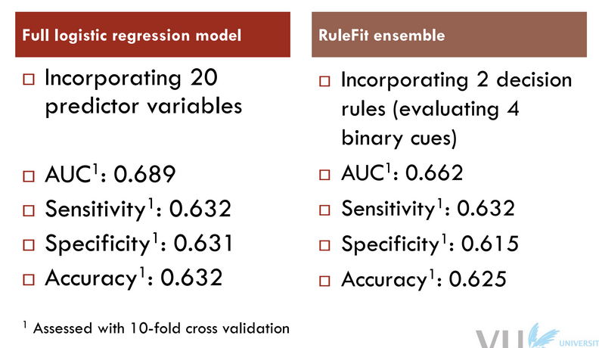
Prediction rule ensembles: Application

Slide 23
Fitting prediction rule ensembles
Rulefit software: not so user-friendly
New R package: pre
well-documented
more flexible
allows for plotting the ensemble
uses algorithm for deriving rules that does not suffer from biased variable selection
Available from GitHub and CRAN

Slide 24
Rulefit algorithm for deriving prediction rule ensembles
Take sub- or bootstrap samples from training data
Grow tree on every sample
Using classification and regression tree algorithm of Breiman et al. (1984)
Create initial ensemble
Include every node from every tree as a rule, and/or
Include predictor variables as linear functions
Select final ensemble by sparse regression on training data
Lasso, ridge or elastic net
Optimal value of penalty term determined by k-fold cv

Slide 25
pre algorithm for deriving prediction rule ensembles
Take sub- or bootstrap samples from training data
Grow tree on every sample
Unbiased recursive partitioning (Hothorn, Zeileis & Hornik, 2006)
Boosting: learning rate > 0
Random forest: Use random subset of mtry variables for split selection
Create initial ensemble
Include every node from every tree as a rule, and/or
Include predictor variables as linear functions
Select final ensemble by sparse regression on training data
Lasso, ridge or elastic net
Optimal value of penalty term determined by k-fold cv

Slide 26
Resolution
Does pre kill the bad?
Does the good survive?

Slide 27
Preliminary simulation results
PRE vs. linear lasso regression, random forest and single tree
Data-generating parameters:
Sample size
250 – 1,000
Signal / noise ratio
.25 - .50
True model
linear, rules, rules + linear, tree
Number of noise variables
15 – 85
≈ 1,500 datasets

Slide 28
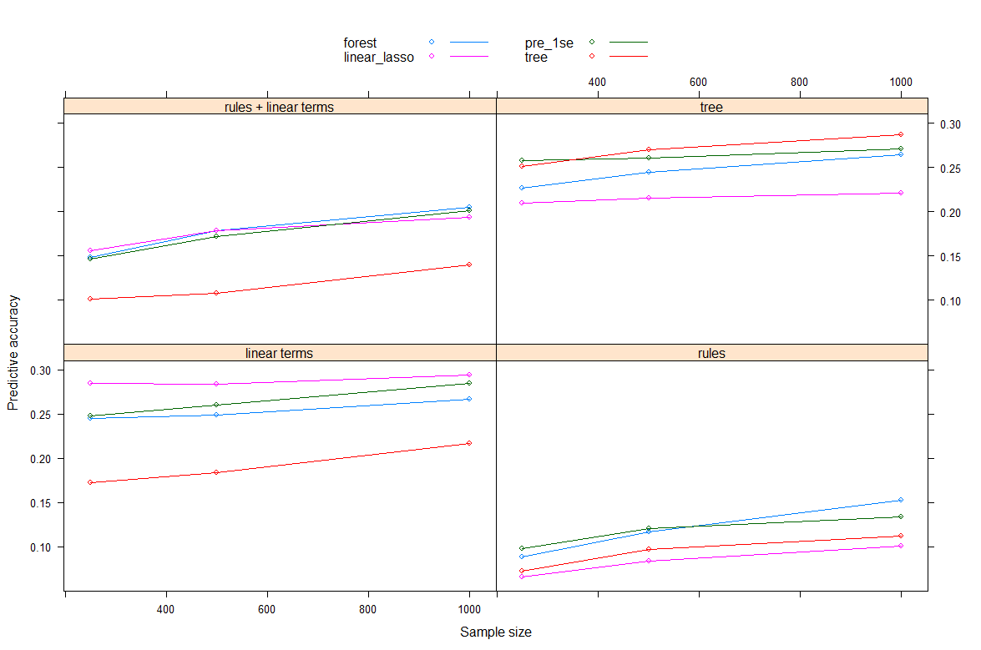
Predictive accuracy

Slide 29
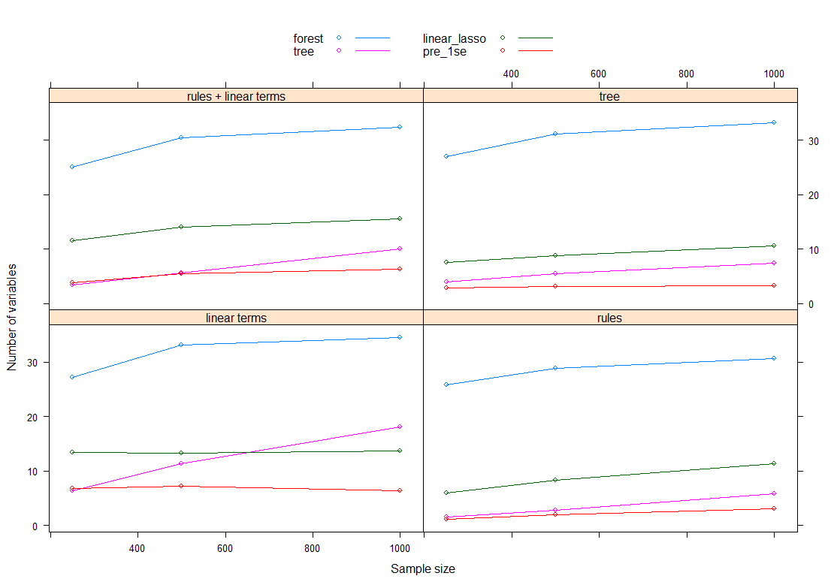
Interpretability

Slide 30
Discussion
A trade-off between accuracy and interpretability applies (very small ensembles have lower accuracy)
Like with random forests, many tuning parameters, have to be chosen wisely
Much work to do still. Next aim: multilevel dataset structures

Slide 31
Thank you for your attention!
https://tinyurl.com/pre-tutorial
Prediction rule ensembles:
Fokkema, M., Smits, N., Kelderman, H., & Penninx, B. W. (2015a). Connecting clinical and actuarial prediction with rule-based methods. Psychological Assessment, 27(2), 636.
Fokkema, M. (2017). Pre: Prediction Rule Ensembles. R package version 0.2.1; available from https://github.com/marjoleinF/pre.
Friedman, J. H., & Popescu, B. E. (2008). Predictive learning via rule ensembles. The Annals of Applied Statistics, 2(3), 916-954.
Geraedts, A. S., Fokkema, M., Kleiboer, A. M., Smit, F., Wiezer, N. W., Majo, M. C., ... & Penninx, B. W. (2014). The longitudinal prediction of costs due to health care uptake and productivity losses in a cohort of employees with and without depression or anxiety. Journal of Occupational and Environmental Medicine, 56(8), 794-801.

